Slide 1


Yen Po Liu
10/12/2022

Slide 2

Outline
Executive Summary
Introduction
Methodology
Results
Conclusion
Appendix

Slide 3
Executive Summary
Summary of methodologies
Data Collection through REST API
Data Collection with Web Scraping
Data Wrangling
Exploratory Data Analysis with SQL
Exploratory Data Analysis with Data Visualization
Interactive Visual Analytics with Folium
Machine Learning Prediction
Summary of all results
Exploratory Data Analysis (EDA) result
Interactive analytics in screenshots
Predictive Analytics result

Slide 4
Introduction
Project background and context
SpaceX advertises Falcon 9 rocket launches on its website with a cost of 62 million dollars; other providers cost upward of 165 million dollars each, much of the savings is because SpaceX can reuse the first stage. Therefore if we can determine if the first stage will land, we can determine the cost of a launch. The goal of this project is to develop a machine learning prediction pipeline to predict if the first stage will land successfully.
Problems you want to find answers
What are the critical factors that effect landing outcome of first stage?
How to make the best prediction to first stage landing?
What operating conditions needs to be in place to ensure a successful landing?

Slide 5

Section 1

Slide 6
Methodology
Executive Summary
Data collection methodology:
REST API and Web scraping
Perform data wrangling
One-hot encoding was applied to categorical features
Perform exploratory data analysis (EDA) using visualization and SQL
Perform interactive visual analytics using Folium and Plotly Dash
Perform predictive analysis using classification models
How to build, tune, evaluate classification models

Slide 7
Data Collection - API
Data collected through API to connect endpoint. (https://api.spacexdata.com/v4/launches/past )
Request
Request the endpoint to get launch data
Normalized
Normalized json format data into data frame structure.
Get
Received raw data in .json format

Slide 8
Data Collection – Web Scraping
Data collected from Wikipedia (https://en.wikipedia.org/w/index.php?title=List_of_Falcon_9_and_Falcon_Heavy_launches&oldid=1027686922 )
Request
Requested webpage to get text data in HTML format.
Transform
Transformed HTML data into data frame through pandas module.
Parse
Applied beautiful soup module as a parser to extract launch table.

Slide 9
Data Collection – SpaceX API
GitHub URL: https://github.com/YbLiu1127/IBM-Data-Science-Capstone/blob/main/Data%20Collection.ipynb
Request
Request to endpoints.
Extract launch data into lists through API functions.
Wangling
Normalize data structure, extract columns to lists respectively.
Cleaning
Filter that data to only include “Falcon 9 ”launches.
Import lists in to dictionary, transform into data frame.
Replace null in “Payload column” with mean value.

Slide 10
Data Collection - Scraping
GitHub URL: https://github.com/YbLiu1127/IBM-Data-Science-Capstone/blob/main/Web%20Scraping.ipynb
Place your flowchart of web scraping here
Request
Request to Falcon9 launch Wikipedia webpage.
Parse
Parse the HTML with beautiful soup module, find out the Falcon 9 launch table.
Extract
Implement “for loop”, extract each cell from table, fill up new launch dictionary.

Slide 11
Data Wrangling
Perform exploratory data analysis and determine training labels
GitHub URL: https://github.com/YbLiu1127/IBM-Data-Science-Capstone/blob/main/Data%20Wrangling.ipynb
Analysis
Use “value counts” to determine the number and occurrence of orbits and launch sites.
Add column
Create a landing outcome label from outcome column that is going to be predicted in the next step.
Identify
Exploring landing outcomes feature, classify all outcome situation into binary stage(1 for succeed ,0 for failed )

Slide 12
EDA with Data Visualization
In order to explore the whether features would affect the launch outcome.
Scatter plots: plot out relationship between “Flight number, Launch Site, Orbit Type and Payload Mass”, trying to find trends that might have higher success landing rate.
Line chart: display the trend of success rate increasing.
Bar chart: check if there are any relationship between success rate and orbit type.
GitHub URL: https://github.com/YbLiu1127/IBM-Data-Science-Capstone/blob/main/EDA%20with%20Vusualization.ipynb

Slide 13
EDA with SQL
Display the names of the unique launch sites in the space mission
Display 5 records where launch sites begin with the string 'CCA’
Display the total payload mass carried by boosters launched by NASA (CRS)
Display average payload mass carried by booster version F9 v1.1
List the date when the first successful landing outcome in ground pad was achieved.
List the names of the boosters which have success in drone ship and have payload mass greater than 4000 but less than 6000

Slide 14
EDA with SQL
List the total number of successful and failure mission outcomes
List the names of the booster versions which have carried the maximum payload mass. Use a subquery
List the failed landing outcomes in drone ship, their booster versions, and launch site names for in year 2015
Rank the count of landing outcomes (such as Failure (drone ship) or Success (ground pad)) between the date 2010-06-04 and 2017-03-20, in descending order
GitHub URL: https://github.com/YbLiu1127/IBM-Data-Science-Capstone/blob/main/EDA%20with%20SQL.ipynb

Slide 15
Build an Interactive Map with Folium
Objective: try to observe in geographical view and explore implicit relationship that affect landing outcome.
Markers: launch places and launch events (succeed or failed)
Lines: display the nearest public facility or landmark and its distance from the launch sites.
GitHub URL: https://github.com/YbLiu1127/IBM-Data-Science-Capstone/blob/main/Interactive%20Visual%20Analytics%20with%20Folium%20lab.ipynb

Slide 16
Build a Dashboard with Plotly Dash
Objective: to understand success rate of each site and landing result that base on different payload mass and booster versions
Display each site’s successful landing rate in pie chart and payload mass within booster versions in scatter plot.
GitHub URL: https://github.com/YbLiu1127/IBM-Data-Science-Capstone/blob/main/spacex_dash_app.py

Slide 17
Predictive Analysis (Classification)
Import data with numpy and pandas module, use fix_transform function to normalized and then use train test split function to split data with 20% test size.
Build machine learning models and test them with different hyperparameters using GridSearchCV.
Display models’ accuracy metric.
GitHub URL: https://github.com/YbLiu1127/IBM-Data-Science-Capstone/blob/main/SpaceX_Machine%20Learning%20Prediction.ipynb

Slide 18
Results
Exploratory data analysis results
Interactive analytics demo in screenshots
Predictive analysis results

Slide 19

Section 2

Slide 20
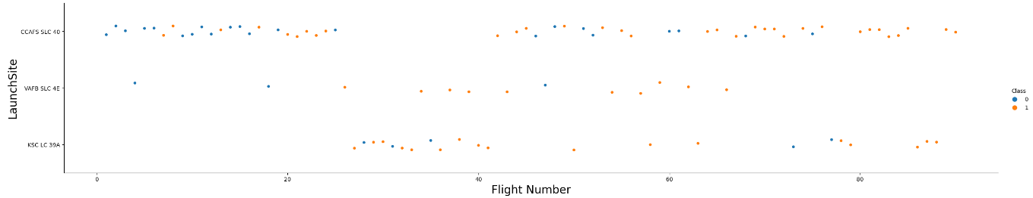
Flight Number vs. Launch Site
According to the plot, we found that in recent launches, it seems to have the most successful landings and highest success rate at CCAFS SLC 40.

Slide 21
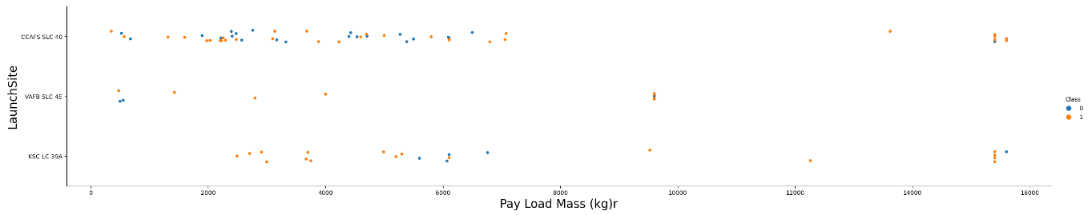
Payload vs. Launch Site
The greater payload mass the higher success rate for launches.

Slide 22
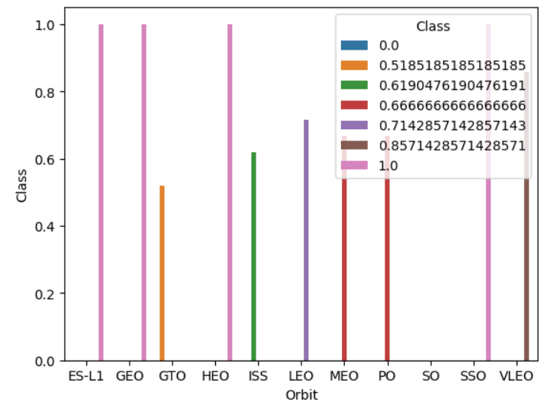
Success Rate vs. Orbit Type
We found out that “ES-L1, GEO, HEO, SSO” orbit type have the highest success rate.

Slide 23
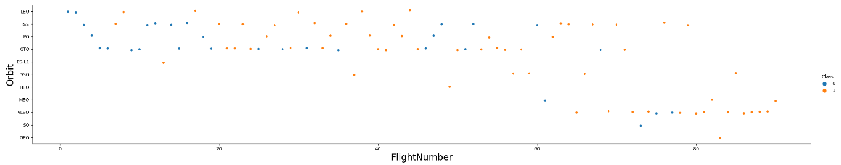
Flight Number vs. Orbit Type
We can tell that according to the red box, it seems that last 5 of orbit type had significantly launched recently, and most of them have higher success rate.

Slide 24
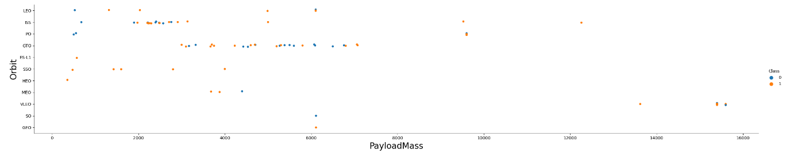
Payload vs. Orbit Type
We can found that with heavy payloads the successful landing or positive landing rate are more for PO, VLEO and ISS.

Slide 25
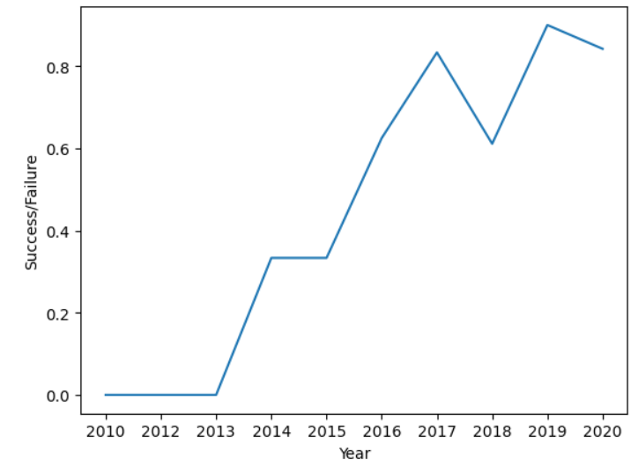
Launch Success Yearly Trend
According to the plot, we can tell that success rate has generally increased in last decade, however, the rate performed in 2018 and 2020 decreased, further analysis is recommend to find out reasons that cause the result.

Slide 26
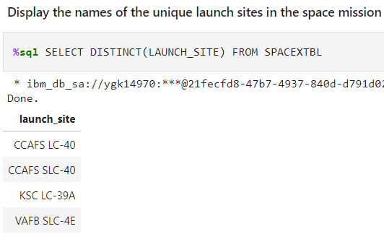
All Launch Site Names
DISTINCT was used when querying unique launch site name from spacex data.

Slide 27
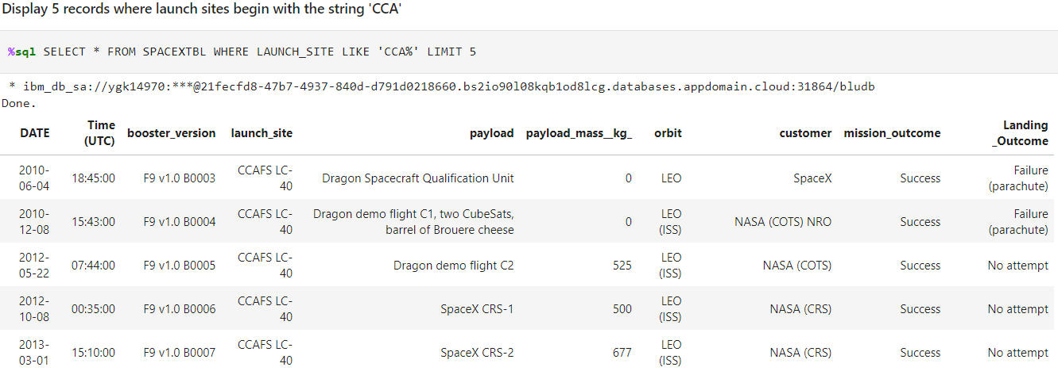
Launch Site Names Begin with 'CCA'
We used the query below to display 5 records where launch sites begin with `CCA`

Slide 28
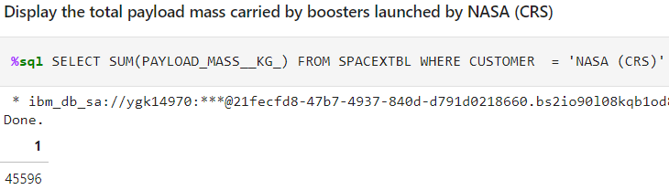
Total Payload Mass
Calculate the total payload carried by boosters from NASA as 45596 using the query below

Slide 29
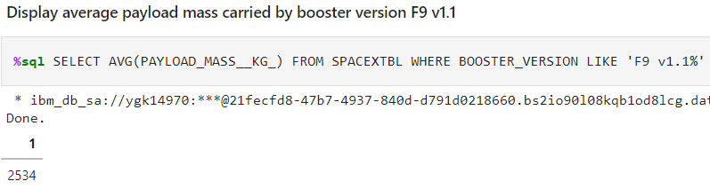
Average Payload Mass by F9 v1.1
Calculate the average payload mass carried by booster version F9 v1.1

Slide 30
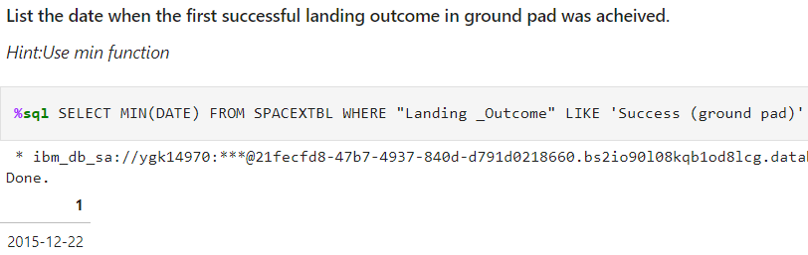
First Successful Ground Landing Date
Found the dates of the first successful landing outcome on ground pad was 2015-12-22

Slide 31
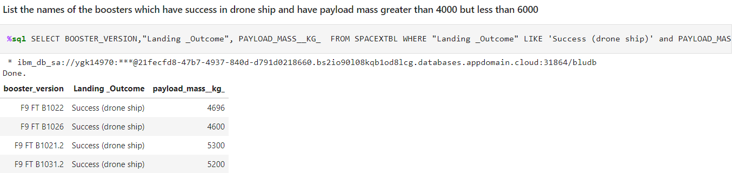
Successful Drone Ship Landing with Payload between 4000 and 6000
We list the names of boosters which have successfully landed on drone ship and had payload mass greater than 4000 but less than 6000

Slide 32
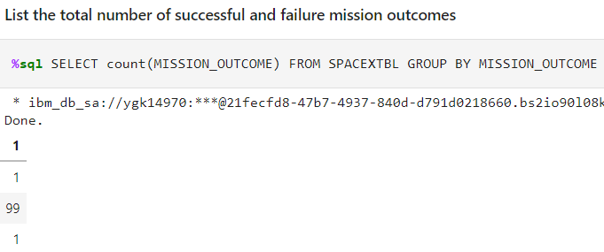
Total Number of Successful and Failure Mission Outcomes
Calculated the total number of successful and failure mission outcomes by using count(MISSION_OUTCOME)

Slide 33
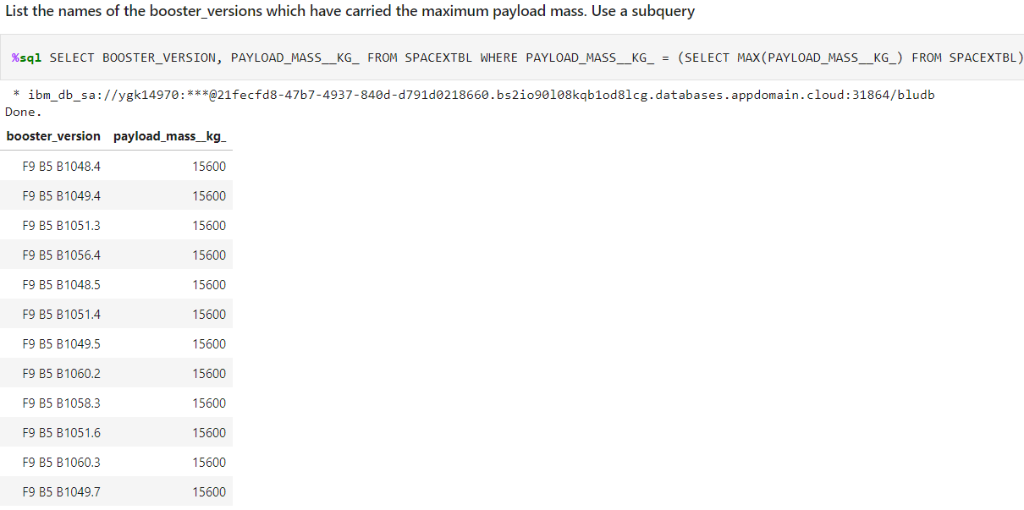
Boosters Carried Maximum Payload
We extracted the names of the booster which have carried the maximum payload mass by using subquery.

Slide 34
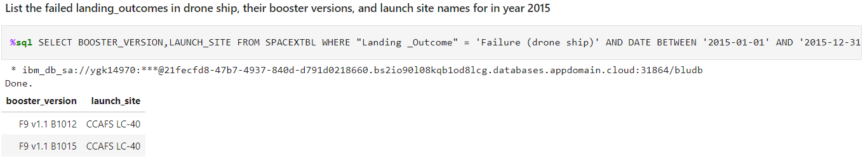
2015 Launch Records
List the failed landing_outcomes in drone ship, their booster versions, and launch site names for in year 2015, set query date between 2015/01/01 and 2015/12/31

Slide 35
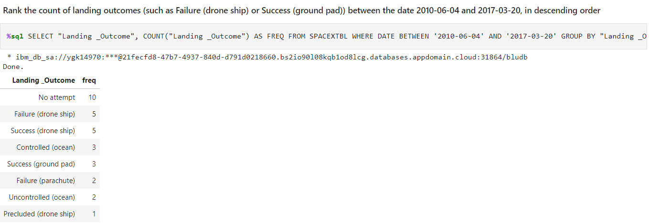
Rank Landing Outcomes Between 2010-06-04 and 2017-03-20
Rank the count of landing outcomes (such as Failure (drone ship) or Success (ground pad)) between the date 2010-06-04 and 2017-03-20, in descending order

Slide 36

Section 3

Slide 37
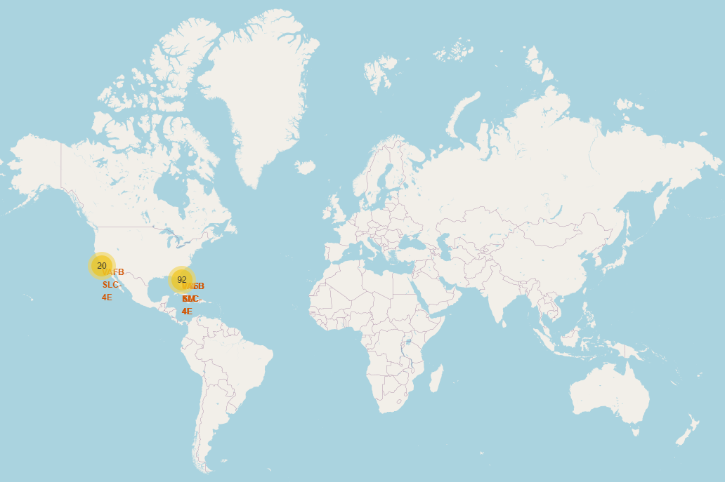
Global map markers – all launch sites
We can discover that all SpaceX launch sites are basically located in coast of United States

Slide 38
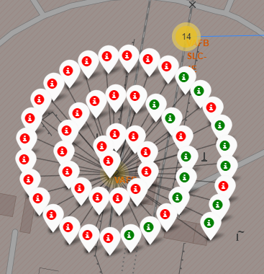
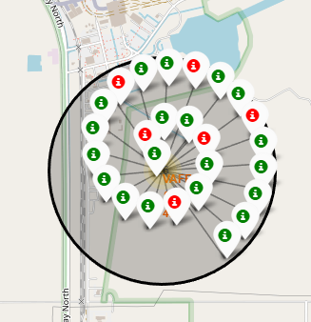
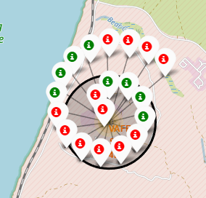
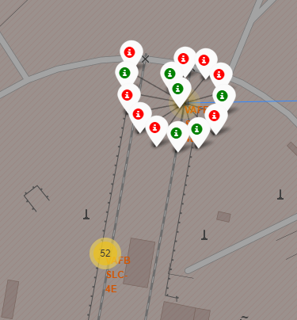
Marker Clusters – launch events
Marker clusters show every launch at each launch site.
Green marker: landing success
Red marker: landing failed

Slide 39
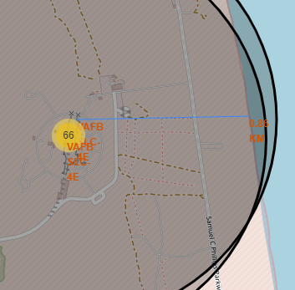
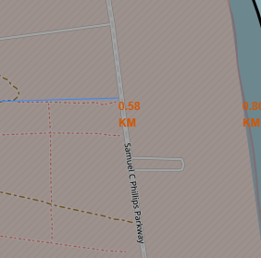
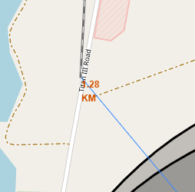
Distance to landmarks

Slide 40

Section 4

Slide 41
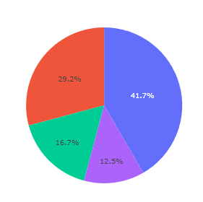
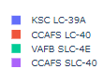
Success count for all launch sites
We can see that launch site KSC LC-39A has the most successful launches.

Slide 42

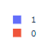
Total success launches for KSC LC-39A
KSC LC-39A achieved a 76.9% success rate while getting a 23.1% failure rate.

Slide 43
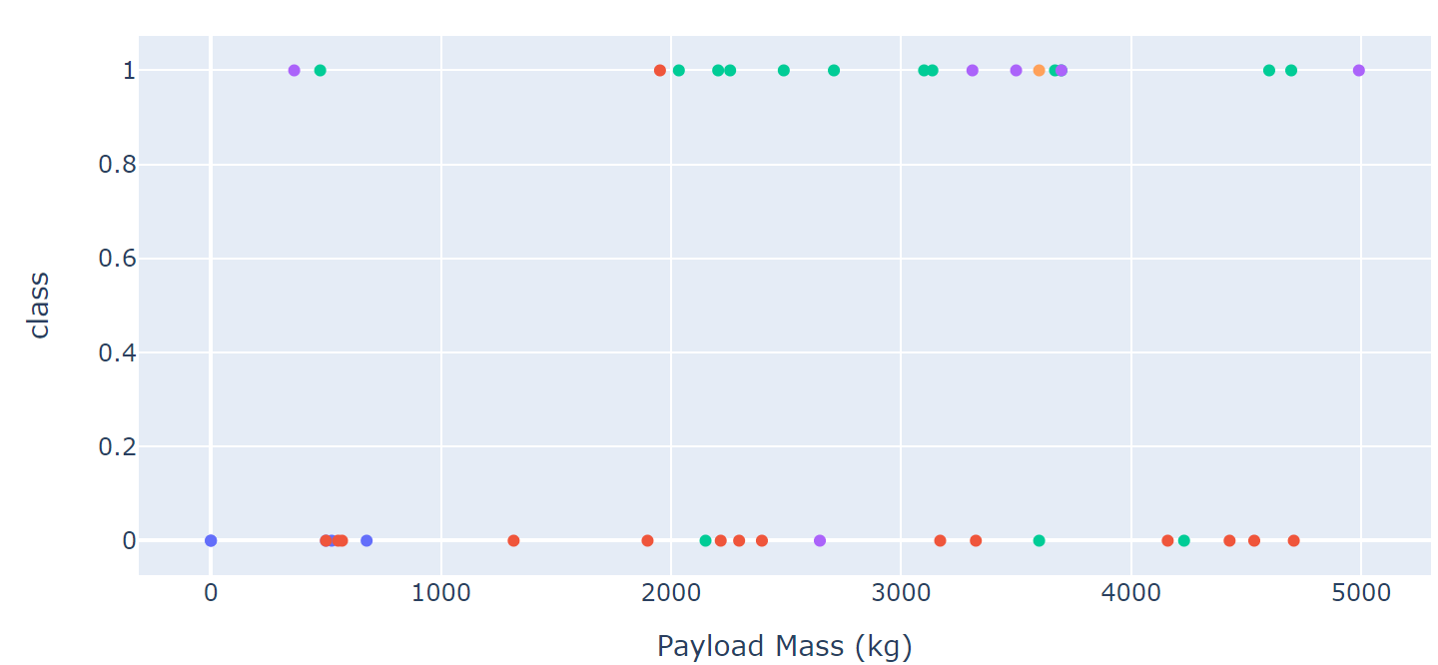
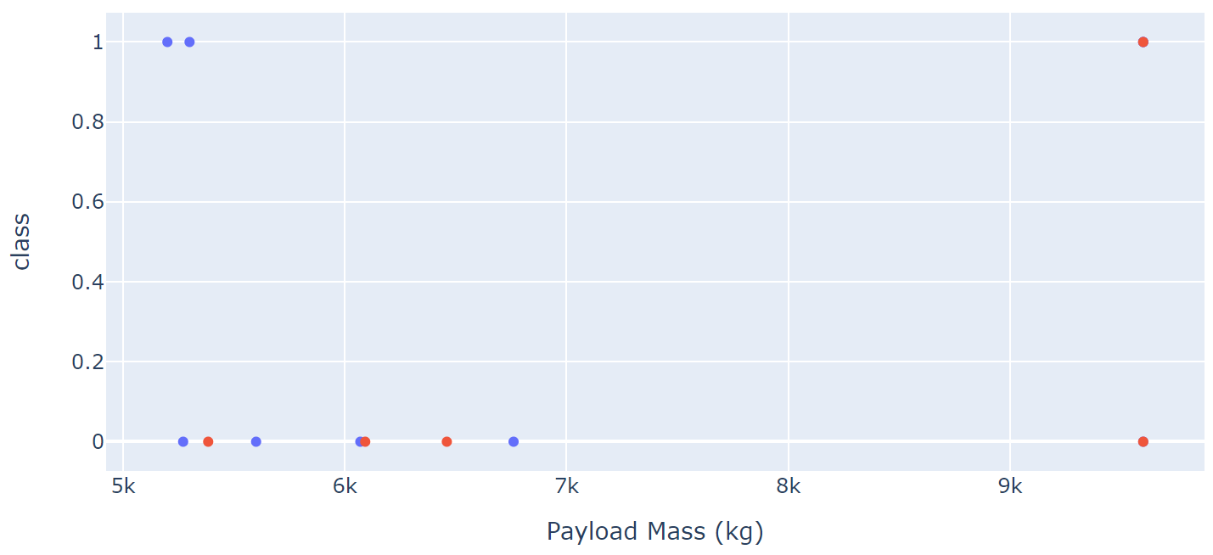
Payload vs. Launch Outcome scatter plot for all sites
We can see that success rate for low payload is higher that heavy payload.

Slide 44

Section 5

Slide 45
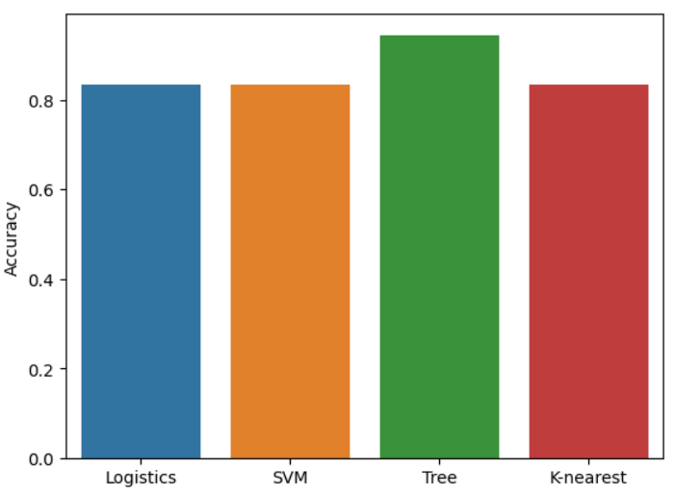
Classification Accuracy
After applying grid search to models, it shows that decision tree model perform the highest accuracy to the prediction.

Slide 46
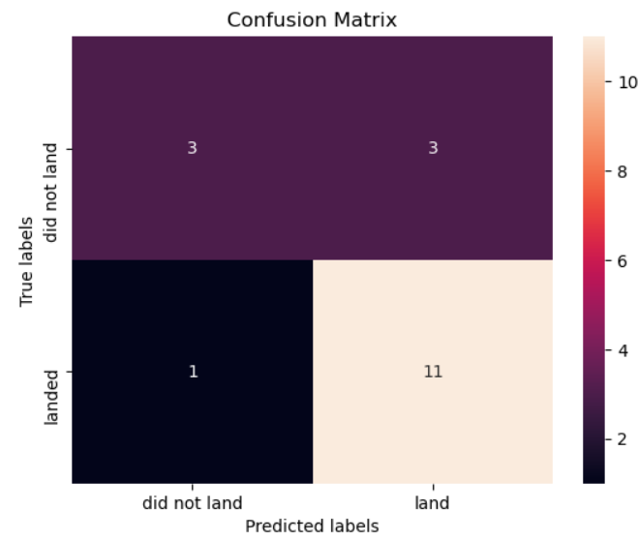
Confusion Matrix
The confusion matrix for the decision tree classifier shows that the classifier can distinguish between the different classes. The major problem is the false positives .i.e., unsuccessful landing marked as successful landing by the classifier.

Slide 47
Conclusions
We can conclude that:
The larger the flight amount at a launch site, the greater the success rate at a launch site.
Generally, launch success rate increased in the last decade.
Orbits ES-L1, GEO, HEO, SSO had the most success rate.
KSC LC-39A had the most successful launches of any sites.
The Decision tree classifier is the best machine learning algorithm for this task.

Slide 48


